Slide 1
Sections Congress Update
R9
Regional Meeting
April 8, 2011
Norberto Lerendegui
R9 SC2011 Coordinator

Slide 2
Sections Congress Committee
Tom Coughlin, Chair
Paul Fortier, Past Chair
Loretta Arellano, Program Committee
Roger Hoyt, Local Organizing Committee
Paul Kostek, Fund Raising Committee
Leonard Bond, 2009/2010 Region 6 Director
Ed Perkins, 2011/2012 Region 6 Director
Mike Andrews, 2013/2014 Region 6 Director
Howard Michel, MGA VP/MGA Board Chair
Babak Beheshti, Chair – MGA Geographic Unit Operations Committee
Cecelia Jankowski, Managing Director – MGA
Cheryl Sinauskas, Director – Geographic Activities
Dan Toland – MGA Geographic Activities
sc-coordinator@ieee.org or www.ieee.org/sc2011

Slide 3
Key Milestones for SC2011
Date | Deadline/Task
4 March | SC2011 Web Site updated – Completed but ongoing
15 March | Breakout Session Abstracts Finalized - Complete
11 April | Registration Open for SC2011
15 April | Breakout Session Speakers Finalized
15 May | Deadline - Recommendations from Regions
1 July | Deadline – Presentations (Breakout Sessions)
21 July | Deadline – early registration
22 July | Deadline – Submission of Primary Section Delegates
1 August | Recommendations distributed to all attendees
12 August | Registration Closes

Slide 4
SC 2011 - Focus Areas
Training
  Emphasize the member – Member Development & resources
  Communicate the value of membership/member engagement
Feedback/Continuous Engagement
  Refined efficient recommendation process to create member-focused recommendations
Networking
  Opportunities for section leaders from around the world to connect with all aspects of the IEEE to improve services for their members
  Poster sessions including local activities and membership opportunities
  Connections with IEEE societies, councils and affinity groups such as at the Sunday CHM event
  Exhibits on IEEE Services/Products available

Slide 5
SC2011 Schedule
Friday, 19 August
  5:30pm - Opening Ceremony, MGA Awards Presentation
  Dinner & entertainment for all attendees
Saturday, 20 August
  8am – 12:00n - Core Track (AM)
  1:00pm & 2:45pm - Breakout Sessions (PM)
  Extra time to visit exhibits/learning labs
  IEEE Honors Ceremony (all attendees)
Sunday, 21 August
  8am, 10:45am & 1:30pm - Breakout Sessions
  9:30am – 10:15am - Plenary Session – VP-MGA
  3:15pm – Discussion of recommendations
  Evening – Computer History Museum Event (Optional)
Monday, 22 August
  Closing Ceremony
  IEEE President-elect candidate discussion
  Voting/Results of Recommendations
5

Slide 6
Breakout Sessions
Tracks
  Empower the Member (Track Chair - Dee Fultz)
  Enhance Geographic Unit Vitality (Track Chair – Enrique Alvarez)
  Serve the World (Track Chair – Bill Gruver)
  Currently 31 topics have been accepted
  Maximum 50 individual breakout sessions
      18 Sessions will be offered twice
      2 Sessions will be broadcasted via ieee.tv
    All presentations will be reviewed to ensure that content is clear and consistent with proposed abstract & focused on improving section vitality/partnership with TA
    All presentations will be incorporated into the IEEE Center for Leadership Excellence

Slide 7
Breakout Sessions – Serve the World Track
Topic | Sponsor | # of times
Conducting Conference/Workshops | TAB | 2
Development and Promotion of Section-driven Humanitarian Technology Projects | TAB/MGA | 2
Doing Professional Activities in Your Sections Anywhere in the World | USA | 2
Meeting the Technical Needs of Members through Chapter and Societies | TAB/ MGA | 2
Networking Skills for Professional Success | USA | 2
How to Run a Successful Webinar: Connecting & Educating More Members While Cutting Costs | USA | 1
Managing your Career | USA | 1
The IEEE Distinguished Lecturer Program - how it can benefit your Section Members. | TAB | 1
Women in Engineering - how to engage members in your programs via affinity groups | WIE | 1

Slide 8
Breakout Sessions – Enhance Geographic Unit Vitality
Topic | Sponsor | # of times
Improving IEEE's engagement with Industry | MGA | 2
Engaging New Members: The First Year Member Experience | MGA | 2
Financial Management for Section and Chapters | MGA | 2
Increasing Visibility of Local IEEE activities | MGA | 2
Resources and Tools for Member Development | MGA | 2
Resources and Tools in Support of Sections, Chapters, Affinity Groups | MGA | 2
Section Vitality | MGA | 2
Standards-Related Opportunities to Support Membership Growth and Industry Participation: Why Standards needs MGA? | SA | 2
Generating Income and Improving Communications Within Your Local Section -- for Medium to Large Sections | SCV | 1
IEEE Worldwide Legal Review and Section Partnership | MGA | 1
MGA & TA Conference Best Practices | TAB/MGA | 1
The best way and the best place to publish your best work. | PSPB | 1

Slide 9
Breakout Sessions – Empower the Member
Topic | Sponsor | # of times
Create a Successful Teacher-In-Service Program in Your Section | EAB | 2
Driving member satisfaction across the member life cycle | MGA | 2
Engaging Students and Student Activities | MGA | 2
How the IEEE Foundation Helps Sections Achieve Goals | Found | 2
Leveraging Graduates of the Last Decade (GOLD) Affinity Groups to Engage Students, Members and the Public | MGA | 2
An Introduction to IEEE-HKN and How to Establish an IEEE-HKN Chapter | EAB | 1
IEEE eLearning Library (formerly Expert Now): Tools for Promoting Engineering Education Worldwide | EAB | 1
Life Members - how to engage members in your programs via affinity groups | LMC | 1
Member Career Transitions and Elevations | MGA | 1
Preserving Section History | History Cmte | 1
Revving Your Sections Engine – Turning Off Autopilot! | Atlanta Section | 1

Slide 10
Monday Closing Ceremony
Change from 2008 Program
  Goal – keep attendees @ Congress till the end ☺
  Will provide information on expected timing of events on SC2011 web page
Being structured to emphasize the future & the importance of keeping members engaged
  Future Direction of IEEE
  Keynote speaker - TBD
  Voting & announcement of top recommendations

Slide 11
Sections Congress 2011 Recommendation Process
Recommendation process approved at November 2010 MGA Board meeting has been rolled out
  New instructions sent to all Region Directors and SC coordinators
  Communicating 2008 status to all coordinators
Deadline for recommendations 15 May 2011

Slide 12
Sections Congress – Monday Morning
Recommendations will be presented to the primary delegates for a vote.
The top 5 recommendation in priority order will be included as part of the MGA Project list.
  Remaining projects may be included if resources are available

Slide 13
Poster Sessions
Call for posters sent to broad distribution including newsletters (Scoop and Society Sentinel)
Topics of interest to the membership in the theme of SC2011 and other potential themes/examples:
  Effective collaboration between section, society and Chapters
  Humanitarian projects
  Effective collaboration project between IEEE OUs.
Over 35 abstracts have been submitted to date.
Decisions on which posters (limited to 32) by the end of April 2011
Sessions will be on Saturday/Sunday

Slide 14
Potential R9 Posters
ARGENTINA – Ricardo Taborda
Program of (Local) Distinguished Lecturers – PDL.
CHILE – Leandro Valencia
Atacama Solar Challenge (ASC) – The first Latin American solar car race.
URUGUAY – Marcel Keschner
IEEE Committee for the Promotion of the Electro-Technology Industry in Latin America.
14
Notes:
14

Slide 15
SC 2011 Logistics
15

Slide 16
Hotel Logistics
Dates: 19 – 22 August 2011
City: San Francisco, CA, USA
Hotel: San Francisco Marriott Marquis
Rate: $225 USD + taxes* ($260 with taxes)
Airports: San Francisco (SFO) – 13 miles/21 km
Oakland (OAK) – 19 miles/30 km
San Jose, CA (SJC) – 45 miles/72 km
Mass Transit to downtown SF is available
* IEEE has rate protection clause in contract. If a lower rate is offered over dates of SC2011, the IEEE rate would be adjusted
16

Slide 17
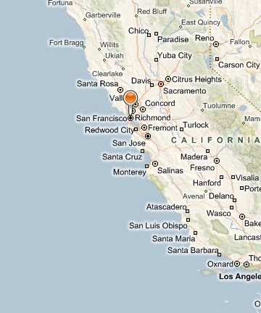
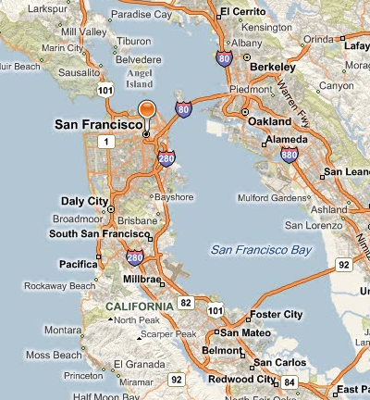
Where is San Francisco, CA?
17

Slide 18
Registration
Delegates
  $525 USD/$575 USD (after 22 July)
    Covers all meals associated with Congress events (except Sunday evening), including Honors Ceremony.
Partners/Children
  $350 USD – Adults/$400 USD (after 22 July)
  $150 USD - Ages of 7 -17/$200 USD (after 22 July)
    Cover breakfast (Saturday, Sunday, Monday) & evening events (Friday, Saturday).
    No fee for children under 6 and below
Registration will open April 2011
18

Slide 19
Expected Expenses - Attendees
$525 – Registration *
$780 – Sleeping Room (3 nights)*
$200 – Misc expenses
$1,505 - Total
  * Covered by MGA
Average Airfare
  $400 – within USA & Canada
  $1,000 - $1,200 – Outside North America

Slide 20
Primary Delegate Criteria
A primary delegate is a member of the Section designated by the Section Executive Committee to represent the Section at Sections Congress.
It is strongly encouraged that the individual be a first time Sections Congress attendee and the Sections should try to fund a younger member (i.e. GOLD).
The primary delegate must be of Graduate Student Member grade or higher in the Section.
A Section must be current in all reporting requirements in order to send a primary delegate. A Region Director can approve an exemption to this requirement.
Submit the list of primary delegates by 22 July 2011

Slide 21

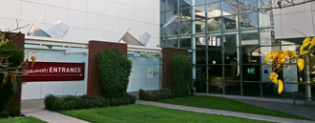
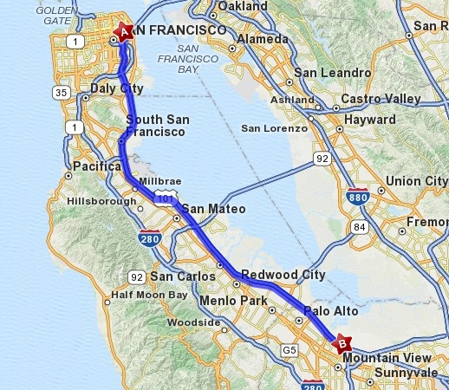

Computer History Museum
Sunday Night Event
Mountain View, CA
Renovated, comprehensive and
interactive computer exhibit opened
in January 2011
Attendees will have a chance to see
the exhibit and enjoy a reception
World’s largest International Collection
of Computing Artifacts
  Hardware
  Photos
  Images
  Documents
  Software
36.4 miles from San Francisco Marriot Hotel to Computer History Museum in Mountain View

Slide 22
Additional Meetings with SC2011
Start Time | End Time | Region | Event |  | Start Time | End Time | Reg |  | Event
Wed-17-Aug |  |  |  |  | Fri-19-Aug
1:00pm | 5:00pm | 4 | ExCom Meeting |  | 8:00am | 4:00pm |  | 1 | Committee Mtg
8:00am | 3:00pm | MGA | GOLD Cmte Mtg |  | 8:00am | 3:00pm |  | n/a | University Partnership Program Mtg
5:00pm | 10:00pm | MGA | GOLD Summitt |  | 8:00am | 12:00n |  | 5 | Committee Mtg
 |  |  |  |  | 8:00am | 11:00am |  | 4 | Committee Mtg
Thu-18-Aug |  |  |  |  | 8:00am | 12:00n |  | 8 | Committee Mtg
8:00am | 12:00n | MGA | GOLD Summitt |  | 8:00 | 12:00 |  | 9 | Committee Mtg
8:00am | 5:00pm | 2 | Committee Mtg |  | 8:00am | 12:00n |  | 10 | Committee Mtg
8:00am | 5:00pm | 3 | Committee Mtg
8:00am | 5:00pm | 4 | Committee Mtg
1:00pm | 5:00pm | 5 | Committee Mtg
8:00am | 5:00pm | 6 | Committee Mtg
8:00am | 5:00pm | 8 | Committee Mtg

Slide 23
Generation of Recommendations
Recommendation (no more than 50 words)
Why is this recommendation being submitted? (no more than 150 words)
MGA Goal/Strategy/Other goal Supported
Identified measures of success (i.e. What does it take to consider this recommendation achieved?)
23

Slide 24
Generation of Recommendations
Was this topic/issue included as a recommendation from a previous Sections Congress
Contact for additional information and Submission Date
Proposed Champion for this recommendation (i.e. person who will follow up, agree to work with MGA Board in achieving this recommendation)
24

Slide 25
SC2008 Examples
Recommendation 4:
The MGA Board to assign staff to develop a user-friendly system and support to enable sections, chapters and affinity groups to deliver, at low cost, teleconferencing, collaborative technologies, and webinars, as a free member benefit.
25

Slide 26
SC2008 Examples
Recommendation 4 - Status:
Completed
DimDim web conferencing tool is available to all Regions
Associated Project:
- Virtual Meetings
26

Slide 27
SC2008 Examples
Recommendation 3:
Provide "Leadership Training Handbook (Text and Multimedia) for Section Officers,” to include:
- Volunteer Recruitment;
- Roles & Responsibilities of Section Chair and Section Committee;
- Presiding at Meetings;
- Documentation - Websites & Forms;
27

Slide 28
SC2008 Examples
Recommendation 3:
- Time Table for Elections & Other Formal IEEE Required Activities;
- Transfer of Responsibilities to Incoming Officers..
28

Slide 29
SC2008 Examples
Recommendation 3 - Status:
Completed
The IEEE Center for Leadership Excellence includes training material for IEEE Volunteers. Five QuickStart modules were made available in 2010.
In Progress -
. . . Additional modules will be delivered prior to SC2011 including modules for Conference Organizers.
29

Slide 30
SC2008 Examples
Recommendation 3 – Associated Proyect:
Center for Leadership Excellence
30

Slide 31
SC2008 Examples
Recommendation 2:
Payment Flexibility - Members, especially students and those in developing countries who do not have credit cards, need flexible payment methods regardless of location and banking methods; supporting aggregated payments in local currency; minimizing transaction costs and processing overheads.
31

Slide 32
SC2008 Examples
Recommendation 2 - Status:
Pilot Program Completed. Phase I - Rupee Project. Pilot program launched in India to allow students to pay for memberships in local currency (rupees) - Jan 2010. We are continuing with this program in India for the 2011 renewal
cycle. The program will be reevaluated once we go through a complete renewal cycle.
32

Slide 33
SC2008 Examples
Recommendation 2 - Status:
Pilot Program Completed. The requirement for payment flexibility in other countries will be addressed as part of our globalization efforts when concentrating on membership in a particular country.
33

Slide 34
SC2008 Examples
Recommendation 2 – Associated Proyect:
Payment Flexibility
34

Slide 35
SC2008 Examples
Recommendation 1:
Every member to have an annual entitlement to a limited number of free IEEE Xplore downloads.
35

Slide 36
SC2008 Examples
Recommendation 1 - Status:
Deemed Not Feasible.
The expected outcome will be that we will not be able to act upon the Sections Congress recommendation due to the projected negative impacts on IEEE
Societies.
36

Slide 37
SC2008 Examples
Recommendation 1 – Associated Proyect:
Member Downloads with IEEE Membership
37

